Slide 1
Task 2:
Implement Wave function on the image
Experiment with different parametrizations

Slide 2

Wave Function:
$$T\left(x\right)=x+α.\sin\left(vx−φ\right)$$
where the parameters $α$ , $v$, and $φ$ denote
the amplitude
the frequency
the phase of the wave

Slide 3
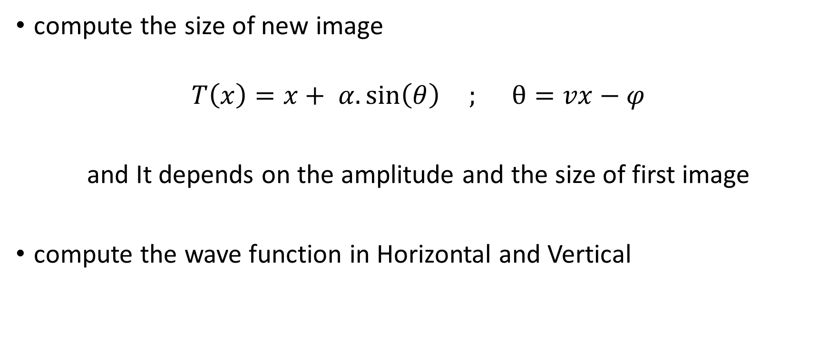
compute the size of new image
$$T\left(x\right)=x+ α.\sin\left(θ\right) ; θ=vx−φ$$
and It depends on the amplitude and the size of first image
compute the wave function in Horizontal and Vertical

Slide 4
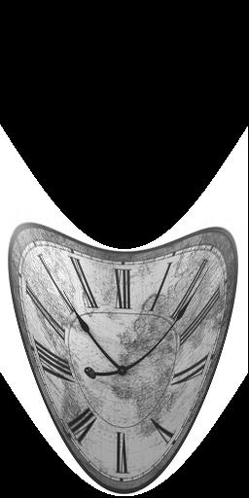
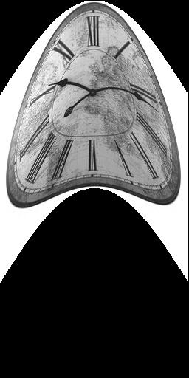
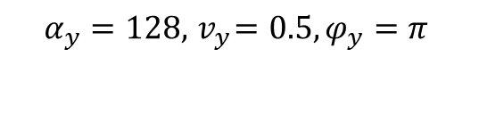
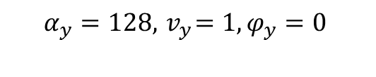
Results :
$$α_{y}=128, { v}_{y}=0.5,φ_{y}=π$$
$$α_{y}=128, { v}_{y}=1,φ_{y}=0$$

Slide 5
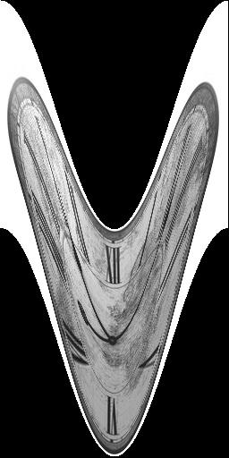
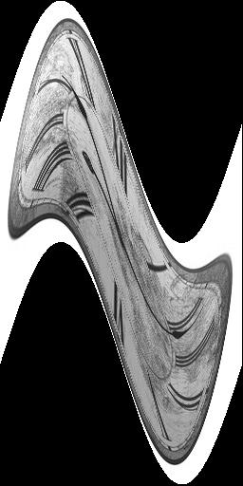
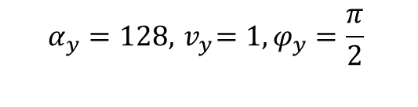
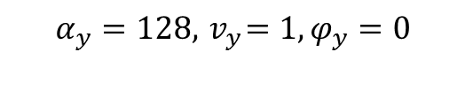
$$α_{y}=128, { v}_{y}=1,φ_{y}=0$$
$$α_{y}=128, { v}_{y}=1,φ_{y}=\frac{π}{2}$$

Slide 6
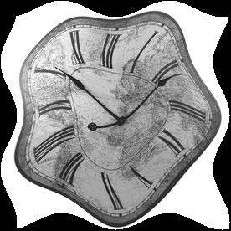
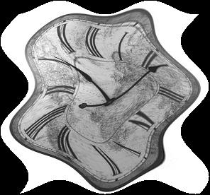
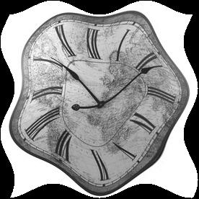
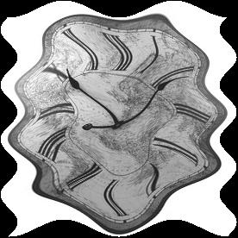


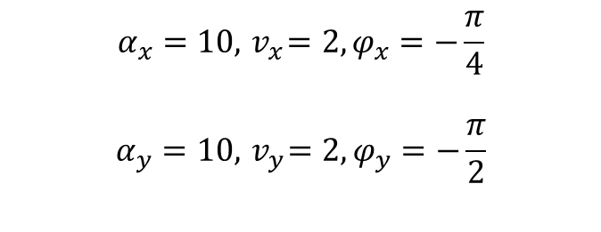

$$α_{x}=10, { v}_{x}=2, φ_{x}=−\frac{π}{4}$$
$$α_{y}=10, { v}_{y}=2,φ_{y}=−\frac{π}{2}$$
$$φ_{x}=−\frac{π}{2}$$
$$α_{x}=20$$
$${ v}_{x}=4$$

Slide 7




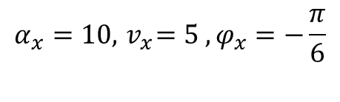
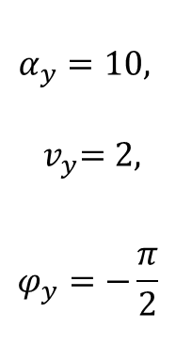


$$α_{y}=10,$$
$${ v}_{y}=2,$$
$$φ_{y}=−\frac{π}{2}$$
second
$$α_{x}=15, { v}_{x}=5, φ_{x}=−\frac{π}{6}$$
$$α_{x}=10, { v}_{x}=5 , φ_{x}=−\frac{π}{6}$$
$$α_{x}=15, { v}_{x}=7, φ_{x}=−\frac{π}{6}$$

Slide 8
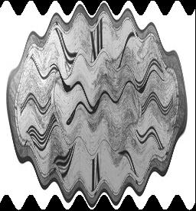
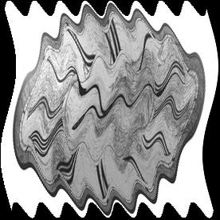

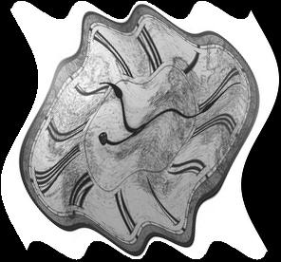
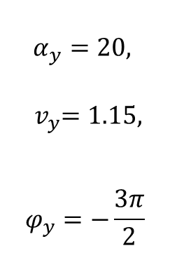
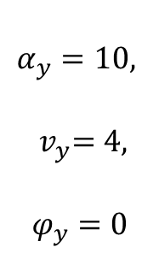
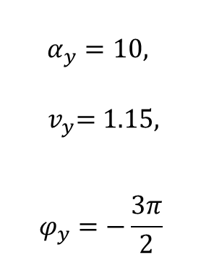
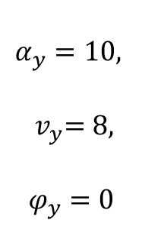
$$α_{y}=10,$$
$${ v}_{y}=8,$$
$$φ_{y}=0$$
$$α_{y}=10,$$
$${ v}_{y}=1.15,$$
$$φ_{y}=−\frac{3π}{2}$$
$$α_{y}=10,$$
$${ v}_{y}=4,$$
$$φ_{y}=0$$
$$α_{y}=20,$$
$${ v}_{y}=1.15,$$
$$φ_{y}=−\frac{3π}{2}$$

